Slide 1

TITLE: UBER DATA ANALYTICS

Slide 2
Introduction
In the rapidly evolving landscape of the tech industry, companies like Uber have redefined traditional business models by leveraging advanced technologies. One pivotal aspect that has garnered increasing attention is customer satisfaction, as businesses recognize its fundamental role in ensuring long-term success. This recognition has led to a surge in interest and investment in data-driven approaches to understand and enhance customer experiences.
The "Uber Data Analytics" project is a response to this paradigm shift, aiming to delve into the intricacies of customer satisfaction among Uber users. By harnessing the power of big data techniques, this project seeks to extract meaningful insights from the vast amounts of transactional data generated within the Uber platform. The integration of data science methodologies, machine learning techniques, and open-source tools is poised to offer a comprehensive understanding of customer behaviors, preferences, and pain points.

Slide 3
Objective
The primary objective of the "Uber Data Analytics" project is to analyze customer satisfaction by employing a big data
approach.
By collecting and processing large volumes of data generated from Uber transactions, the project seeks to identify patterns, trends, and insights that can contribute to improving the overall user experience. The goal is to create a data-driven understanding of customer satisfaction factors and provide valuable insights for enhancing Uber's service.
Problem Statement: Despite Uber's efforts to use data science methods, there may still be gaps in understanding customer satisfaction comprehensively. This project addresses the need for a more in-depth analysis of customer experiences by employing big data techniques. Challenges may include handling large datasets, ensuring data quality, and deriving meaningful insights from the complex, dynamic nature of Uber's transactional data.

Slide 4
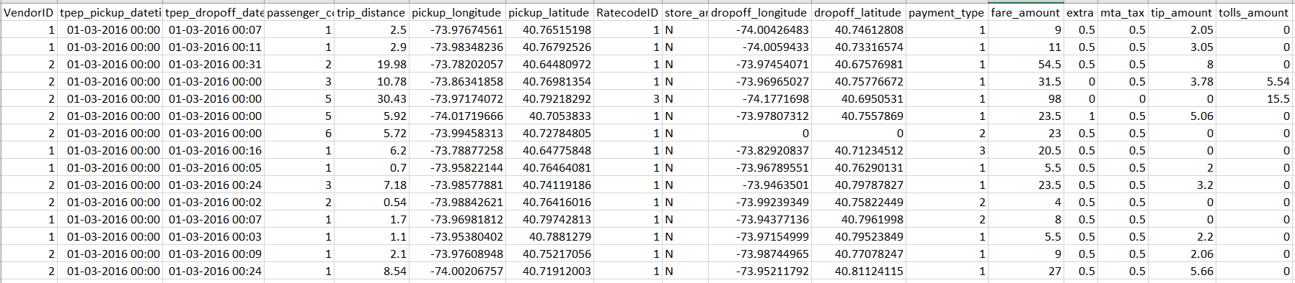
Dataset
Snippet of our dataset
Each row in the dataset represents a specific Uber trip, and the columns provide detailed information about different aspects of each trip, such as time, location, distance, and fare details.

Slide 5
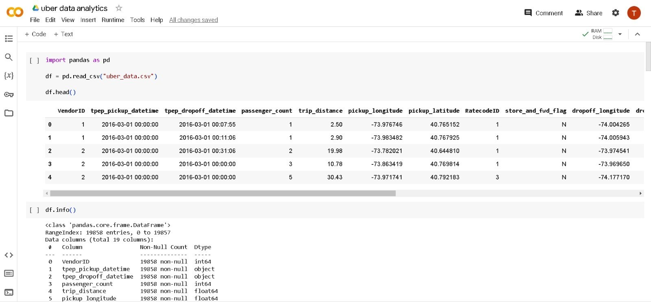

Slide 6
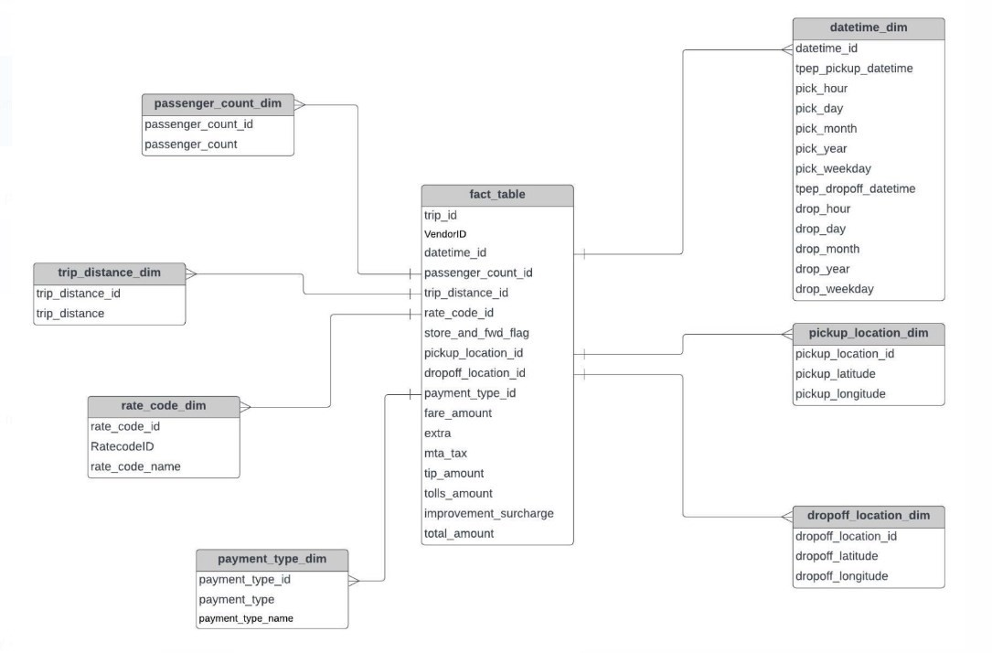
Data Model
This is a class diagram of a passenger ticket system. It shows the relationships between the different classes in the Uber
database.

Slide 7
The class diagram is divided into three parts: dimensions, fact table, and payment type dimension.
Dimensions are descriptive attributes of a fact table – datetime dim, passenger count dim, trip distance dim, rate code dim, pickup location dim and dropoff location dim.
The fact table contains the numeric data for the Uber database – trip_id, VendorID, pickup_location_id, fare amount, extra, mta tax, tip amount, improvement surcharge etc.
The payment type dimension contains information about the payment method that the passenger used to pay for the trip –
payment_type_id, payment_type and payment type_name.
This class diagram is used to understand the relationships between the different data elements in the Uber database.

Slide 8
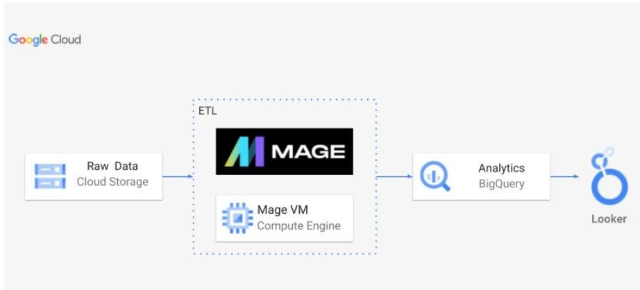
Architecture
The project is built on Google Cloud Platform (GCP), and it uses a variety of GCP services
to collect, store, process, and analyze Uber data.
The Raw Data for the project is collected
from a variety of sources, including Uber's mobile app, driver app, and website.
ETL is a process of extracting data from one or more
sources, transforming it into a desired format, and
loading it into a target system. Our project uses a variety of GCP services to implement its ETL pipeline, including Cloud Data Fusion, Cloud Dataproc, and Cloud Dataprep.

Slide 9
An open-source website called MAGE is utilized as a data pipeline, aiding in the loading of our data and its processing. We will utilize Mage to construct our final dashboard by loading our data onto the massive query that is currently running in the data warehouse.
BigQuery is a fully-managed, petabyte-scale analytics data warehouse that enables businesses to analyze all their data very quickly. It is used to store the transformed data from the ETL pipeline and to run analytics and machine learning jobs on the data.
Mage VM Compute Engine is pre-configured with the tools and libraries that are needed to run machine learning jobs on MAGE. It is also used to run machine learning jobs on the transformed data in BigQuery.
Looker is used to create dashboards and reports that can be used to visualize and analyze the data in BigQuery.

Slide 10
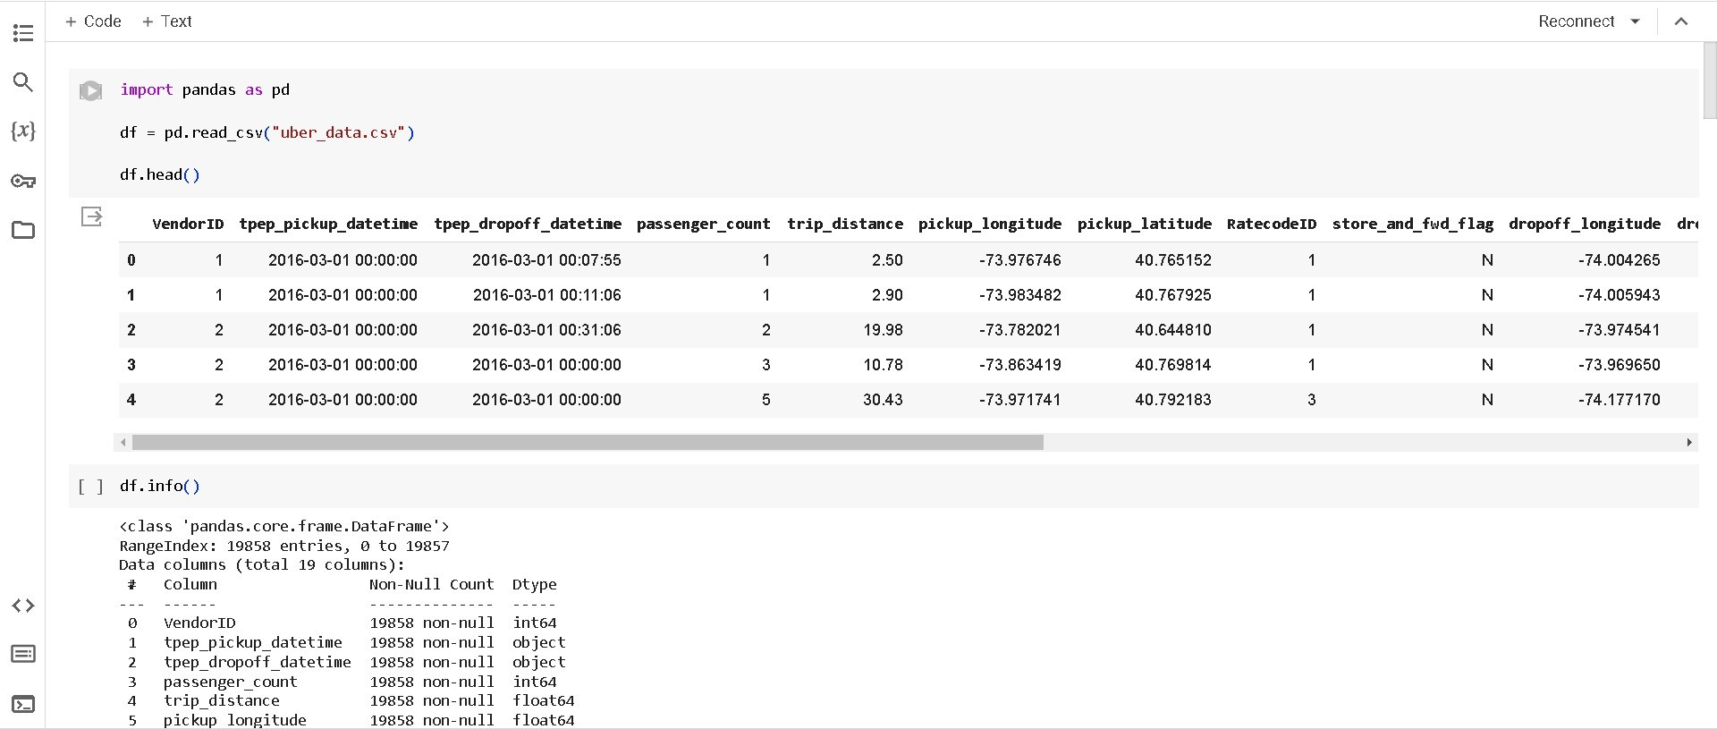

Slide 11
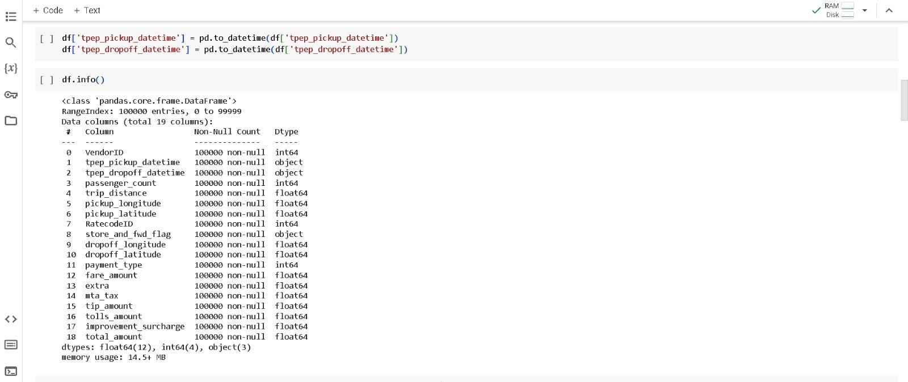

Slide 12
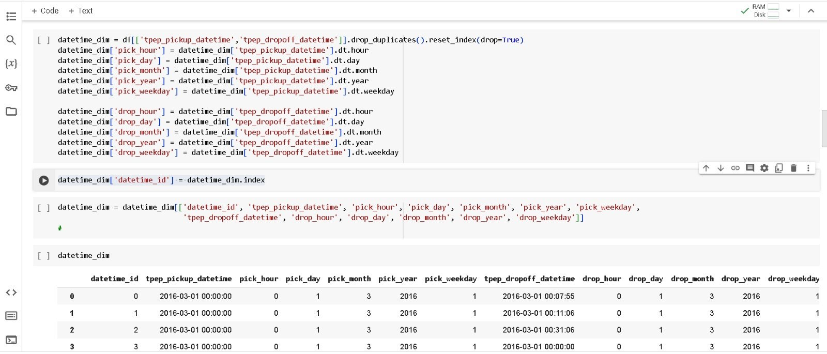
Dropping the duplicates and creating date_time_dim table

Slide 13
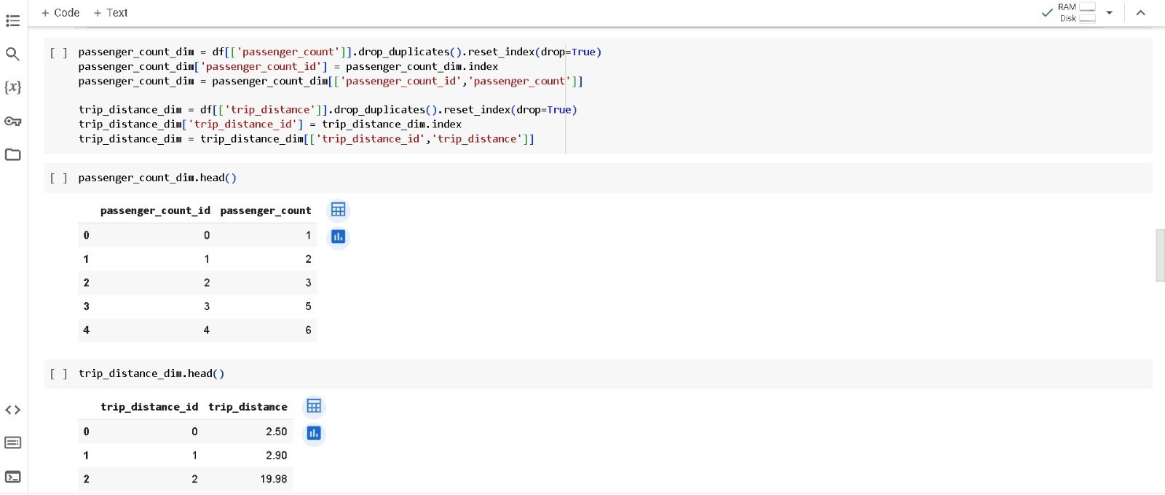
Dropping passenger duplicates and creating passenger_count_dim and trip_distance_dim
tables

Slide 14
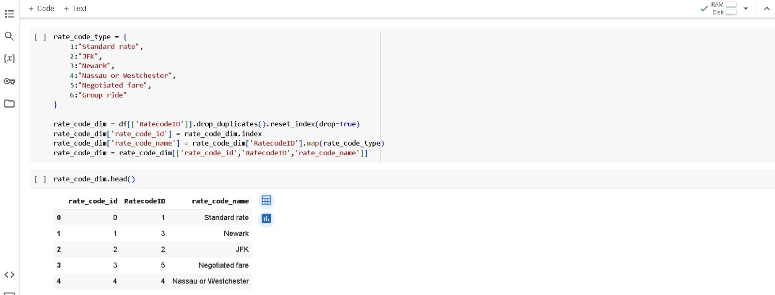
Assigning rate as per the data dictionary, creating rate_code_dim table

Slide 15
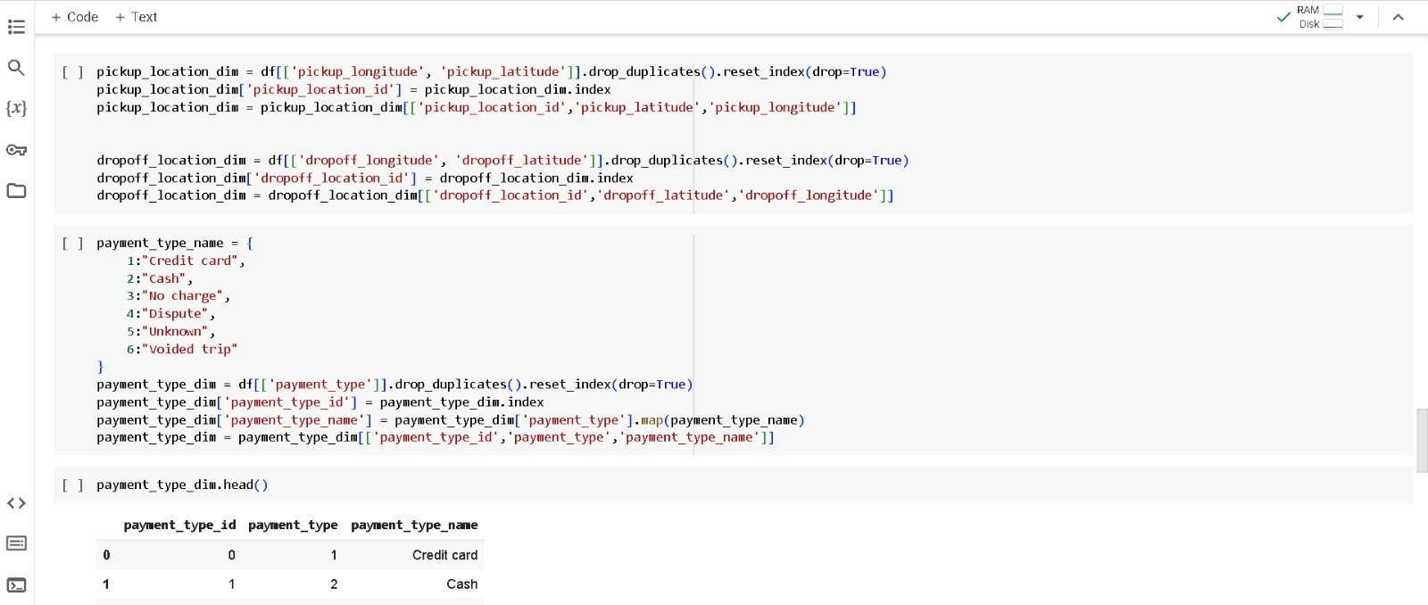
Dropping the duplicates for the pickup & drop, assigning the index and reordering it. Created payment_type_dim table

Slide 16
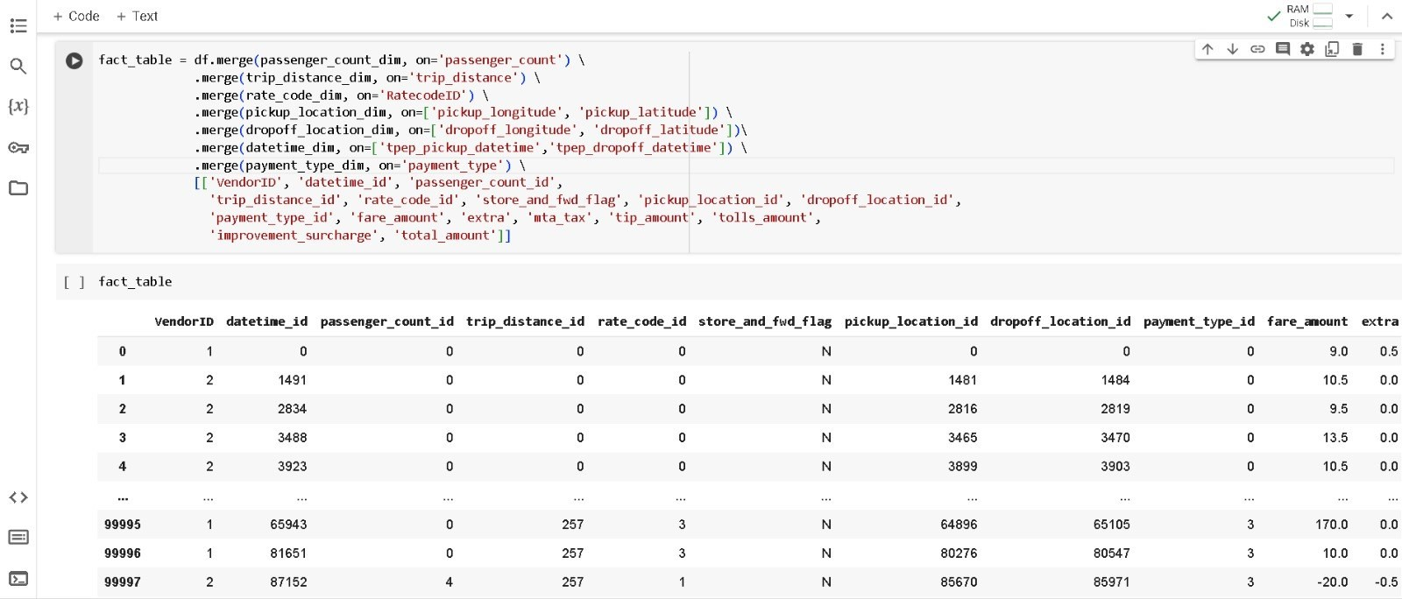
Converting flat file into dimension model for the ‘fact table’

Slide 17
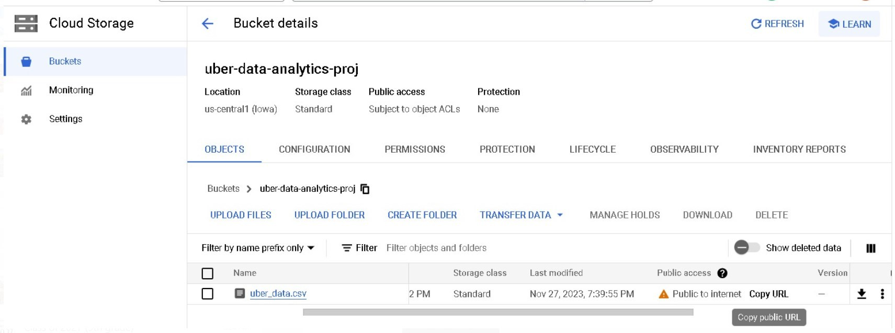
Uber_data.csv file has been uploaded on the cloud storage.

Slide 18
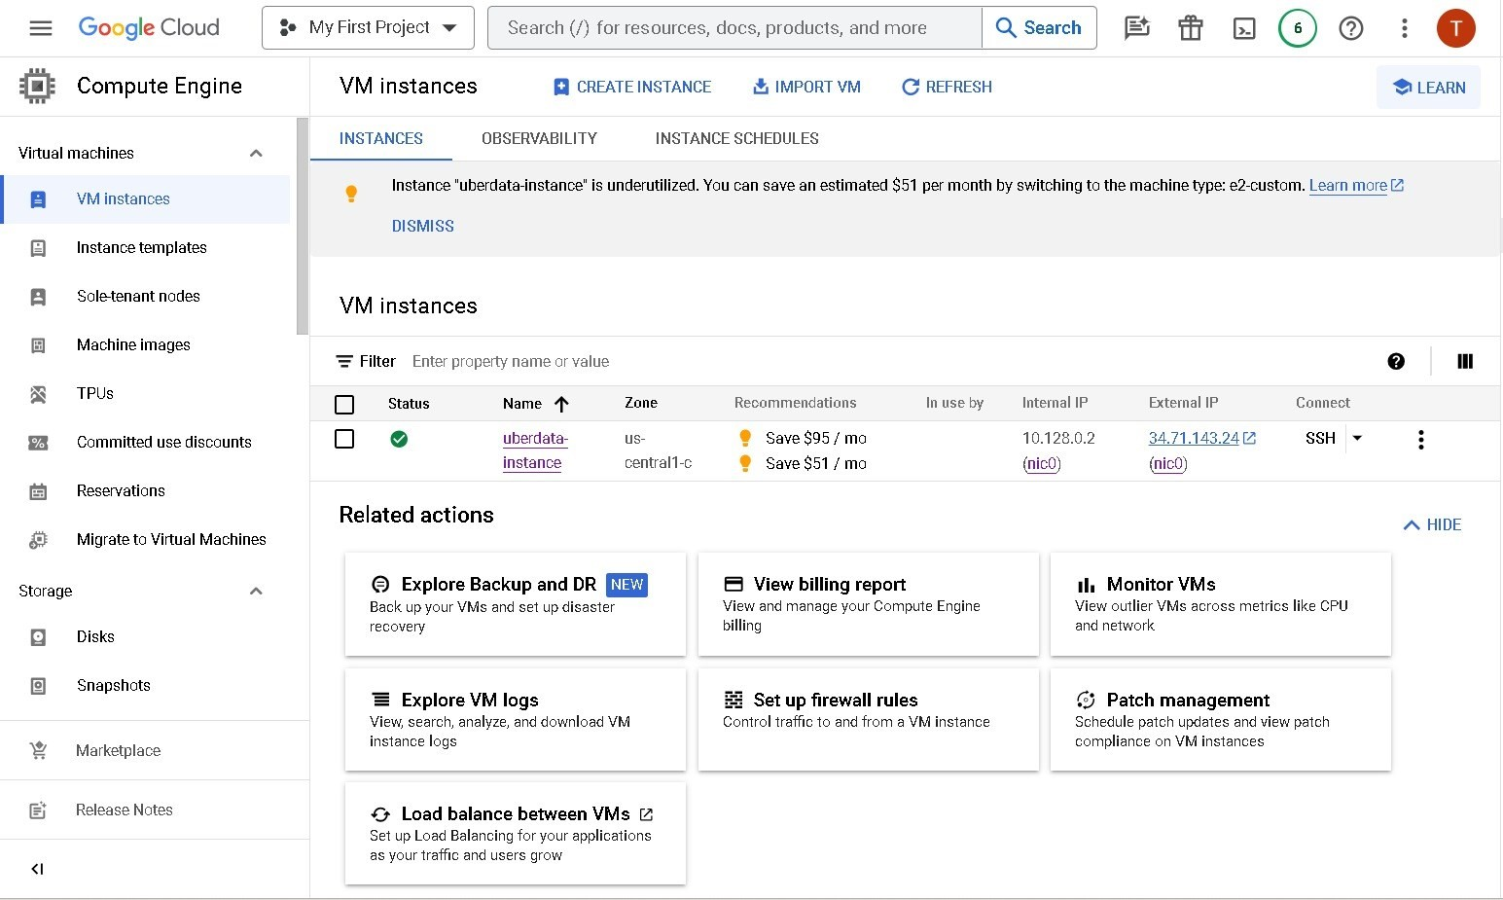
VM instance

Slide 19
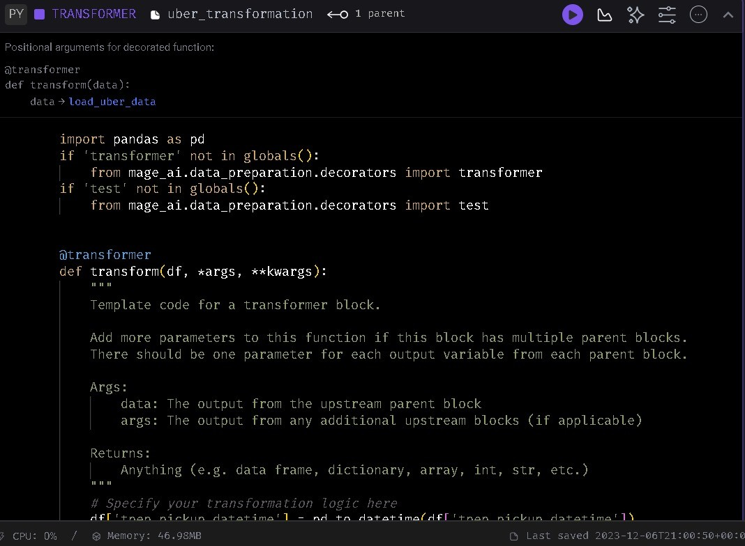
Implementation on MAGE

Slide 20
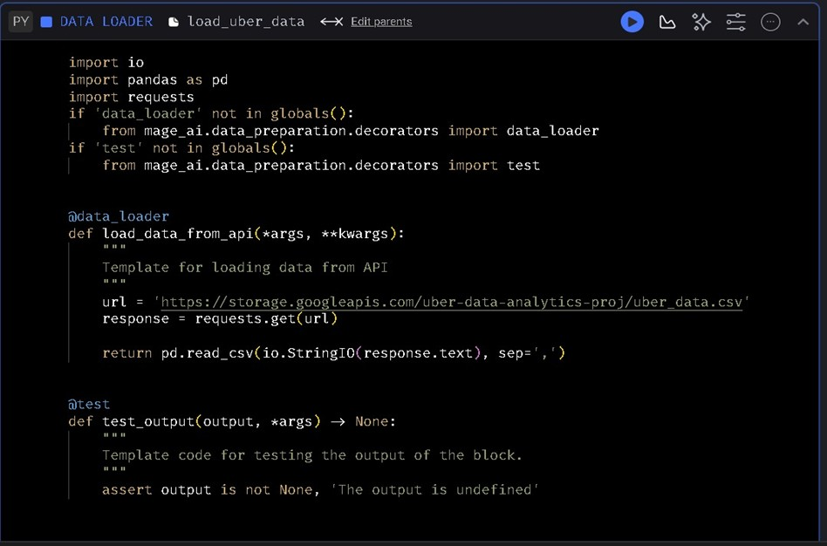

Slide 21
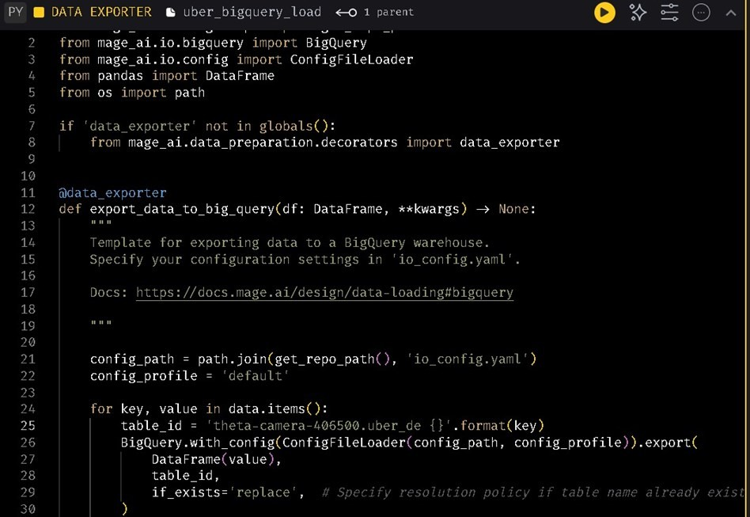

Slide 22
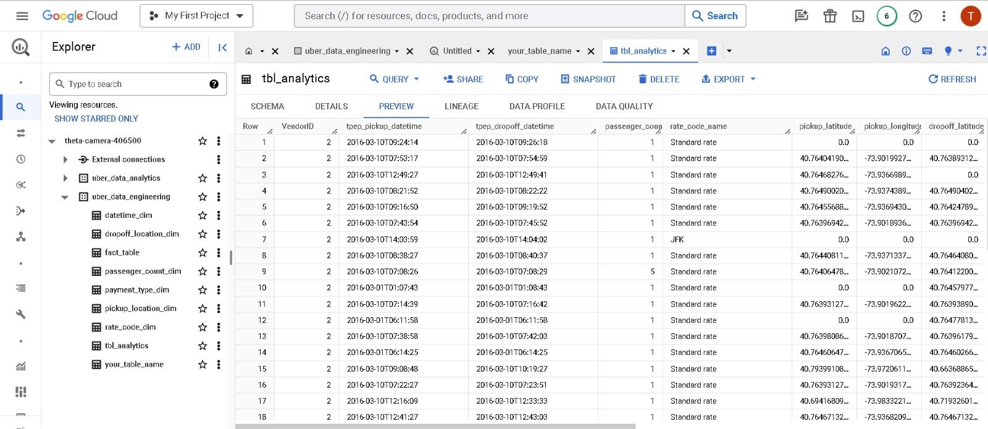
BigQuery

Slide 23
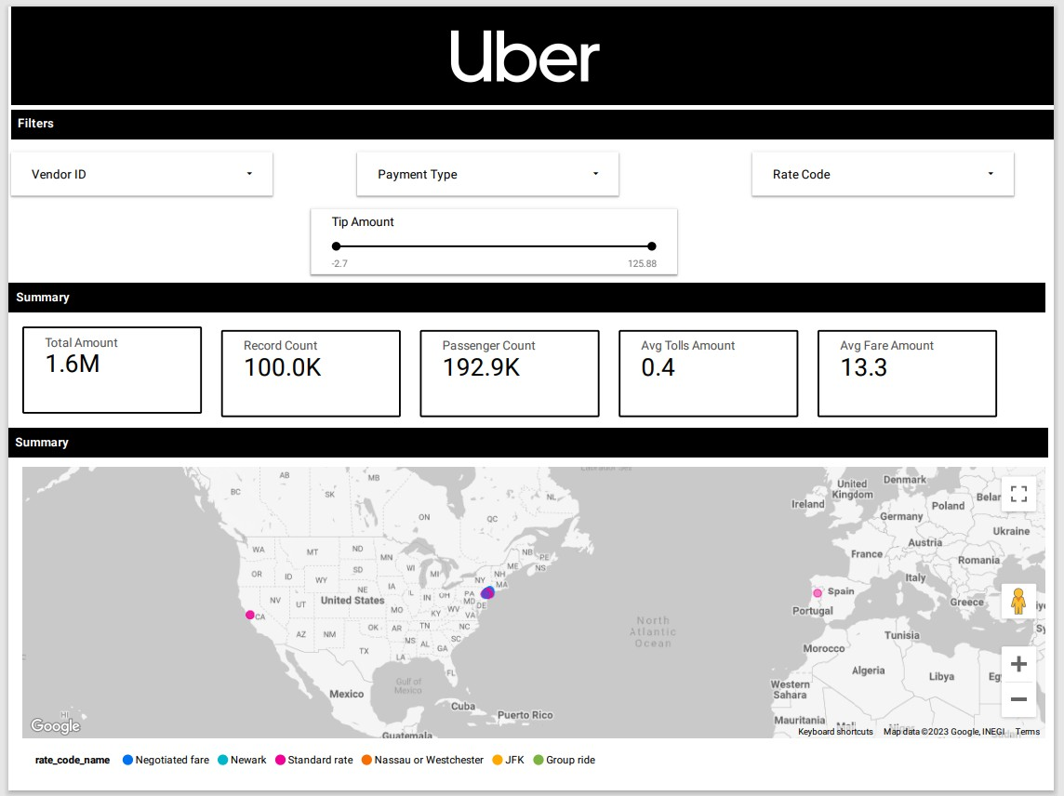
Uber Dashboard
The dashboard can be used to track the performance of Uber in different regions and to identify trends in Uber usage. The dashboard is
a valuable tool and it can be used to improve Uber's services and to make informed decisions about the future of the company.

Slide 24
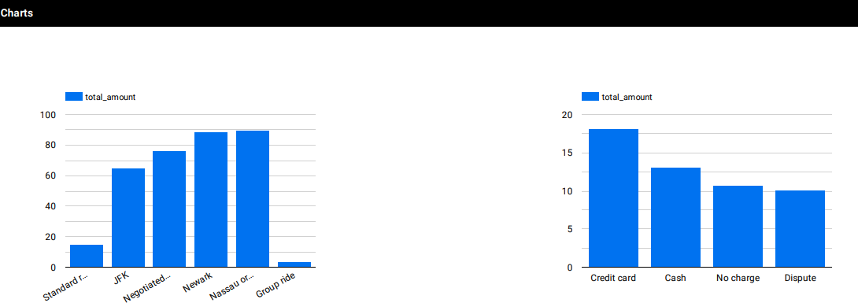
Bar charts displaying different rate code and payment methods.
The chart shows that credit card is the most popular payment method for Uber rides, and Cash is the second most popular payment method.

Slide 25
Conclusion
This large-scale experiment demonstrated the concrete benefits that may be obtained from using big data techniques to comprehend client happiness. Significant insights were obtained from Uber's enormous amounts of unstructured transactional data by integrating scalable and adaptable data pipelines, storage, processing, modeling, analysis, and visualization components. The project's ultimate success was supported by several significant accomplishments, including transferring streams of unprocessed transportation data from dispersed systems into uniform storage, including trips, locations, timings, money, and metadata, Creating frameworks such as the star schema to connect atomic facts and dimensions, improving the accuracy of data, Developing an enterprise-class ETL method to convert massive amounts of detailed data into datasets suitable for analysis, Statistical modeling in conjunction with interactive slicing and dicing to facilitate multidimensional analysis, providing shared dashboards with important patterns and trends to inform strategic choices. Uber's customer-centricity was enhanced by these successes, which gave the initiative concrete insight into passenger preferences, habits, evolving demands, and pain areas throughout travel. It was possible to pinpoint exactly which key parts were causing the friction. Loyalty and promotional campaigns were found to be related. It was estimated how sensitive price thresholds were. In addition, the baseline dashboards, model designs, templated ETL logic, and architecture blueprint created throughout this project help expedite further analytics endeavours. Uber's culture may become more deeply ingrained with data-driven analysis if ownership is transferred to business teams.

Slide 26
References:
Cloud Data Warehousing Solutions https://cloud.google.com/solutions/big-data/
Schema Design for Analytical Workloads https://cloud.google.com/architecture/schema-design-for-analytical-workloads
Streaming Analytics Pipeline Architecture https://cloud.google.com/solutions/big-data/streaming-analytics-pipeline-architecture
Uber's Methodology for Experimentation at Scale https://eng.uber.com/xp/
Recommending Optimal Partners for Uber Service Providers https://dl.acm.org/doi/abs/10.1145/3298689.3346969
Uber Data Analysis & Visualization Case Study https://towardsdatascience.com/uber-data-analysis-visualization-db5759f51b5a
Optimized Bucketing for Uber's Real-time Features Platform https://dl.acm.org/doi/10.14778/3436905.3436924
Ride Sharing Innovation & Managing Emerging Technologies https://www.emerald.com/insight/content/doi/10.1108/JMTM-06- 2018-0133/full/html

